Slide 1
Linkalysis: Network Analytics Suite

Slide 2
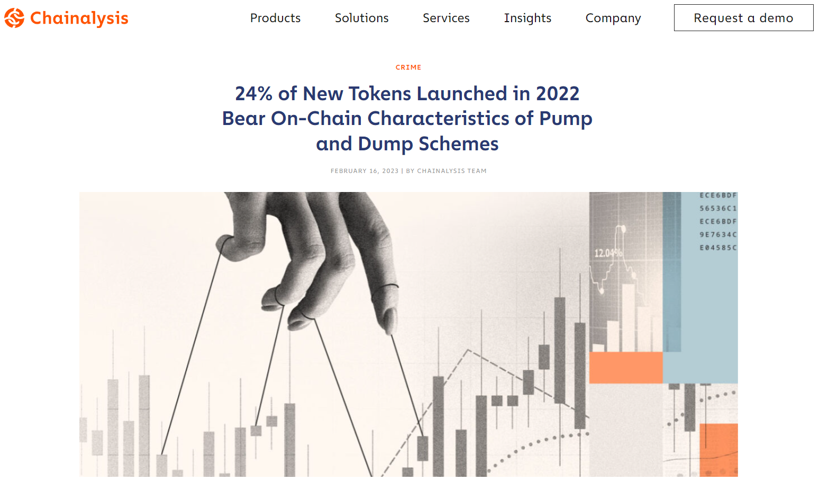
Fake volume & activity is bad for the ecosystem
Artificial pump (and dump) – Token ruggers stole $30mm in 2022 (Source: Chainalysis)
What about NFTs?

Slide 3
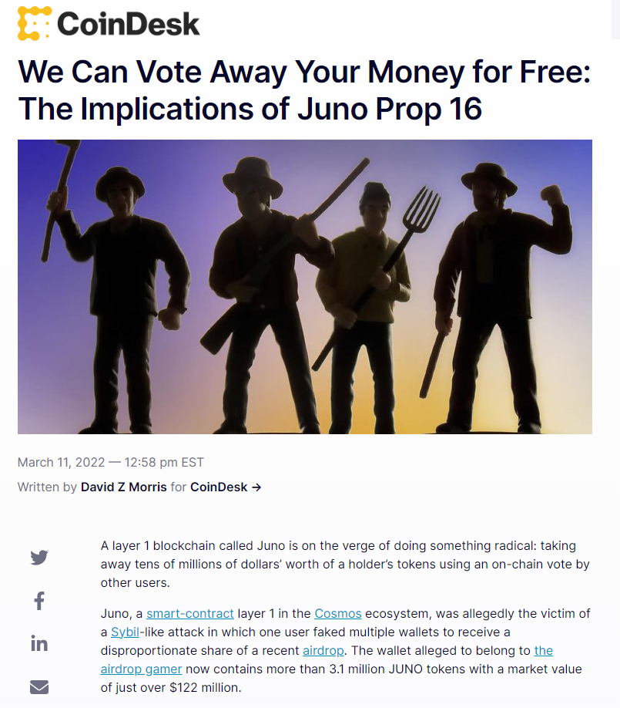
Fake volume & activity is bad for the ecosystem
Sybil liquidity incentives and airdrops
Incentive size (TAM):
180mm (AVAX)
150mm (MATIC)
100mm (BNB)

Slide 4
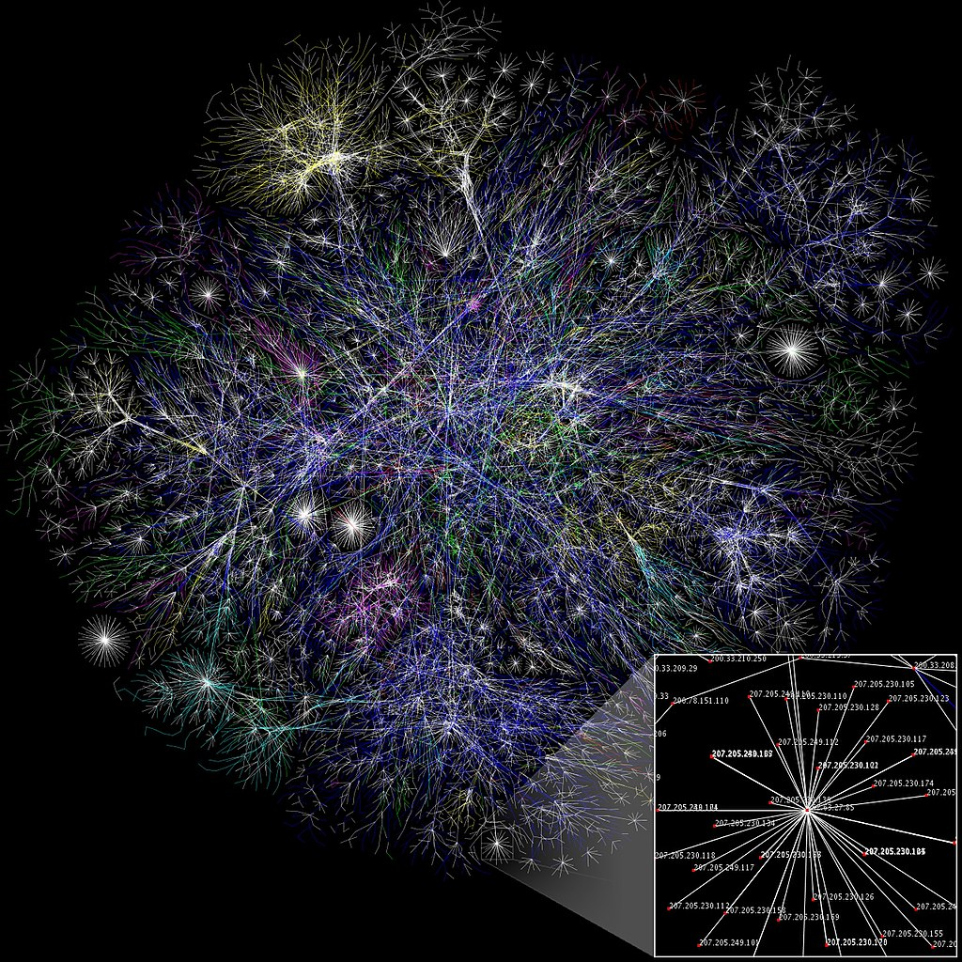
solution: the science of connections
Groups of people and their relations, not individuals!
E.g. Social networks: Humans and friendships
Has answers to big questions:
Who are the important entities?
How to automatically detect communities?
How to model dynamics? (e.g. disease spread)

Slide 5
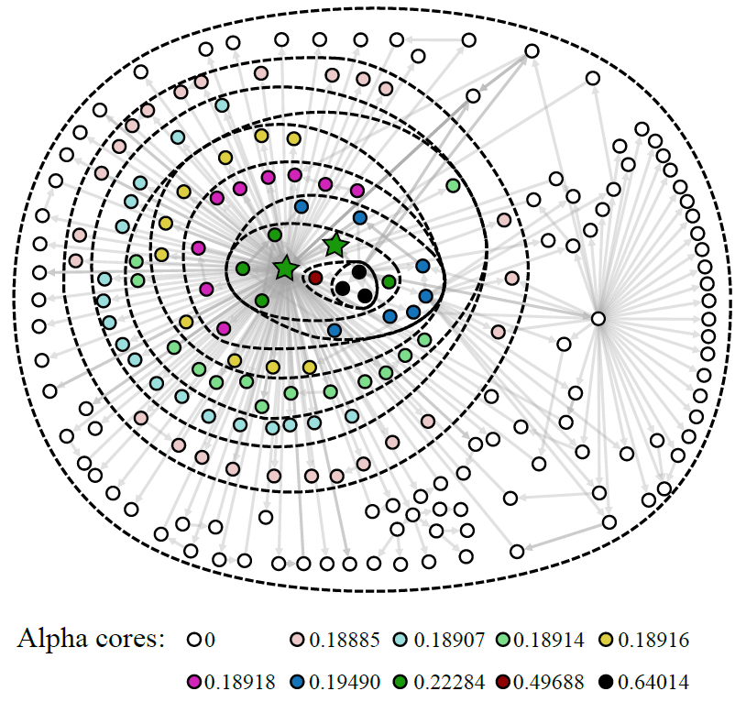
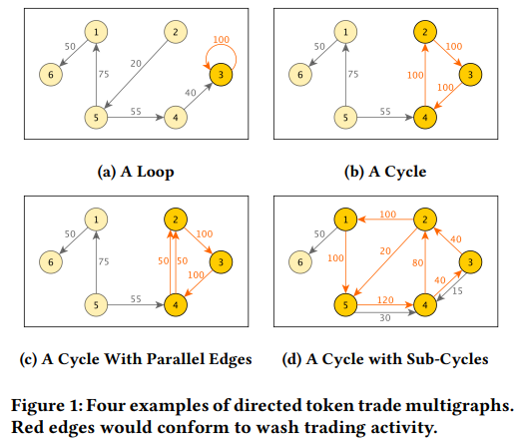
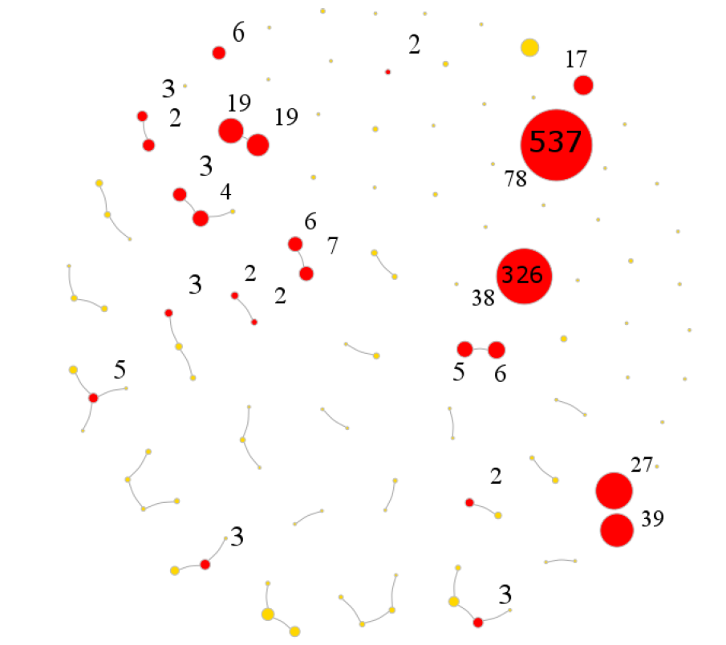
proven track record on ETH and BTC
Victor et al (2021): Detecting CEX addresses (stars) on ETH. Whale-CEX interactions -> alpha?
Akcora et al (2020): Predicting ransomware addresses in advance on BTC (red clusters)
Victor & Weintraud (2021): Detecting DEX wash trades on ETH

Slide 6
Where are the B2C products?

Slide 7


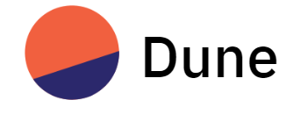
Understanding / Alpha Discovery
Demand for B2C analytics products
Focused on analyzing individuals
Fastest reader in the world (right): 400+ words/second
Solana: ~5000 tps
In Solana, algorithms are a necessity

Slide 8







Recommendation Engine
Wallet interactions
Analyze interactions, sends recommendations

Slide 9




User Engagement
Sell items eg game assets
Observe user interactions with others to monitor ecosystem health

Slide 10
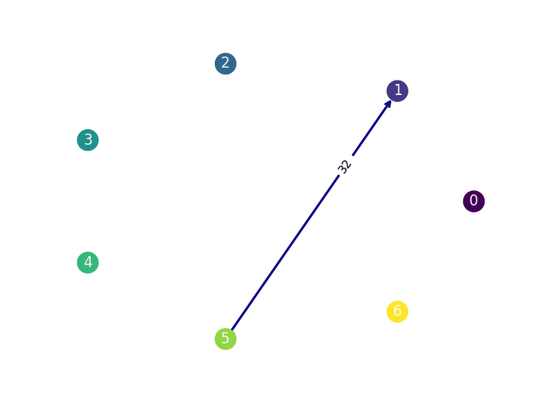
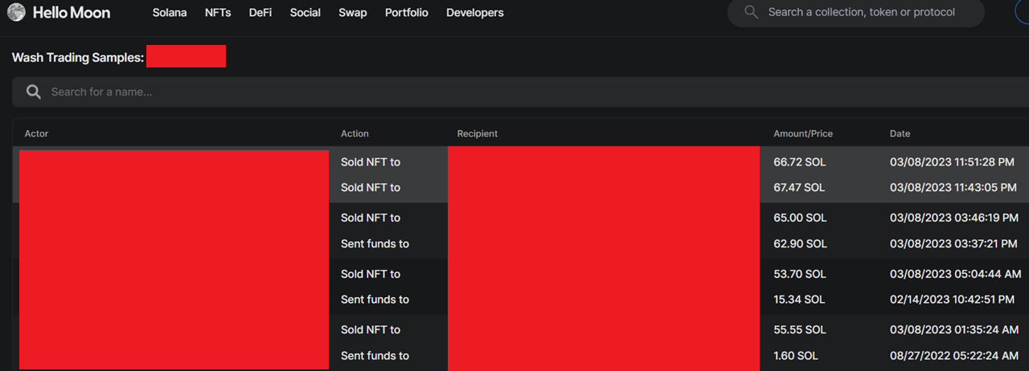
Wash trade detector
Hellomoon: Pairwise transactions
Ours: Discovered “Ring of 7” that trade with each other across 41 tx in1 month
Only possible to spot with machines!
Label: Total tx volume (SOL) over time

Slide 11

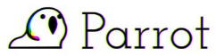






Typical analytics: 3 Mar 2023
Top 10 volume
Top 10 tx count
Star Atlas
Intermediate Smart Contracts
Institutional Yield Farmer

Slide 12


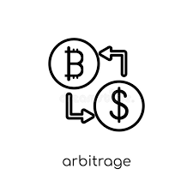


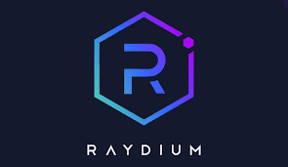
OuR analytics: 3 Mar 2023
(Pari Mutuel?) Betting bots
Arbitrage bots
More exchange addresses
Whale addresses
Understand their strategy and build a better one?

Slide 13
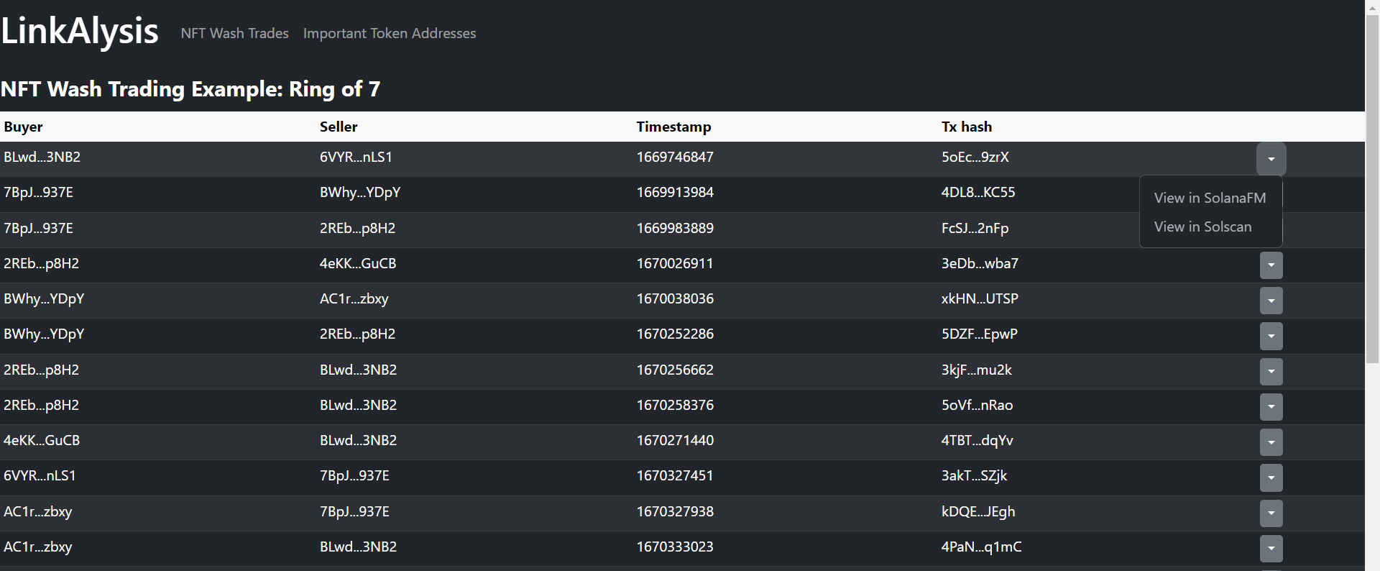
Prototype demo

Slide 14
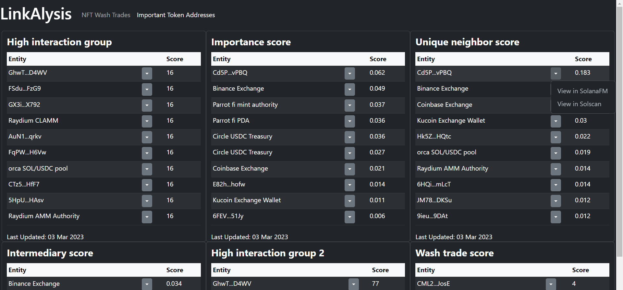
Prototype demo

Slide 15
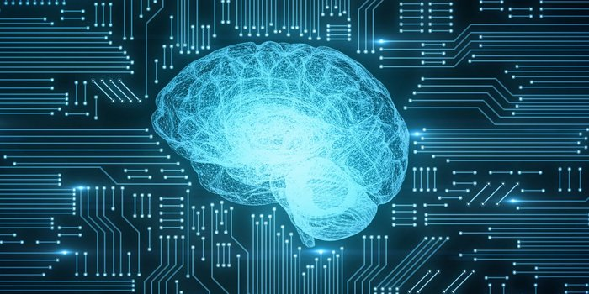


Team
Just me! ~6 years experience in Artificial Intelligence research
Contact Nick: shh_throw at protonmail dot com
Looking for awesome collaborations to unlock the power of network analytics!
Available for hire/ contract work :D
Open to your ideas on AI/ Data Science + Web3! (eg code generation)

Slide 16


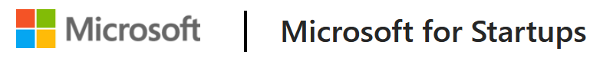
Future work
Full stack deployment: Continuous monitoring
Predicting / Realtime alert for exploits?
Combine various metrics to assess NFT Risk – See NFT Risk Lens!
Special Thanks To:
Consultation
Data
Compute

